Slide 1
World Cup Snowball Project
By Ben Nguyen and Dylan Pham

Slide 2
Methodology
Used Jupyter Notebook to write code
Imported Pandas and Matplotlib to extract/visualize data
Calculated shots by goal zone and accuracy

Slide 3
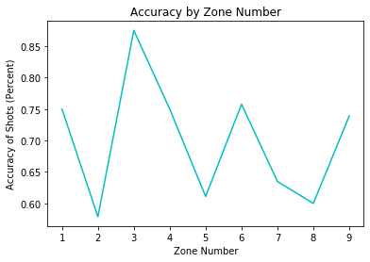
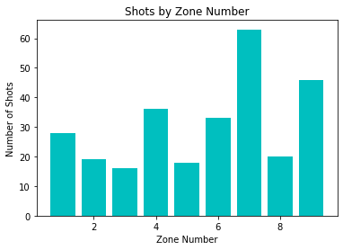
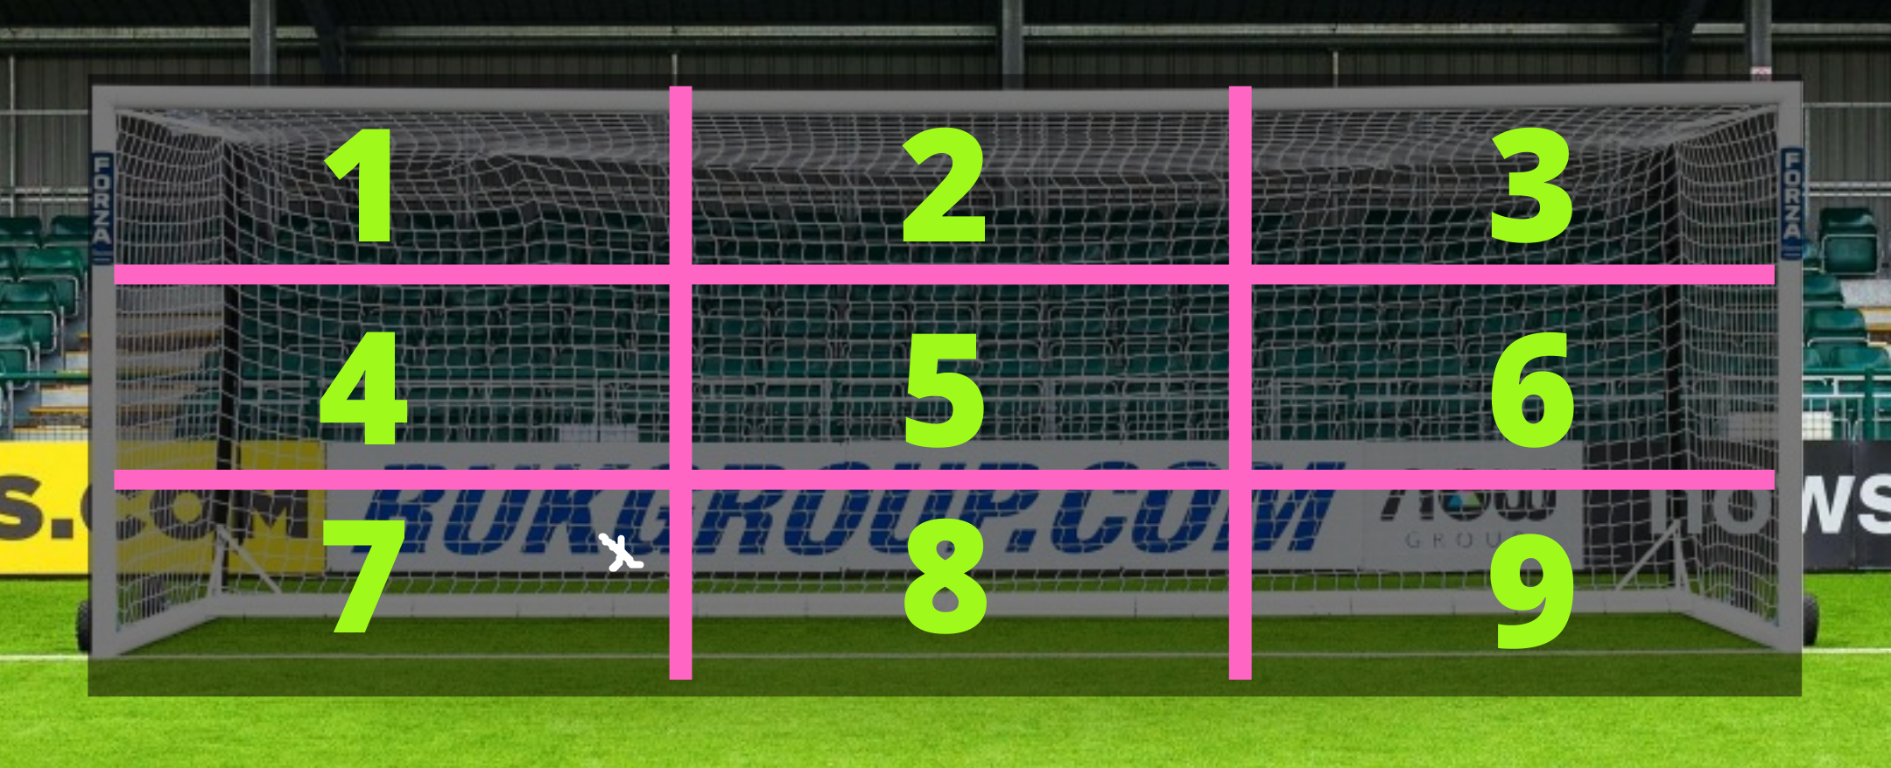
Visualizations

Slide 4
Results
Zone 7 was the most frequent target
Despite having the fewest shots, zone 3 was most accurate
Average shot location: (0.92, 0.79)

Slide 5
Possible Future Work
Examine the accuracy of right vs left footed kickers
See where players kicked the ball on the game-ending penalty

